Slide 1
Posture Watcher Final Presentation
By Phil Johnson, Gerald Killiany, Evan Kutney, and Sean McHale

Slide 2
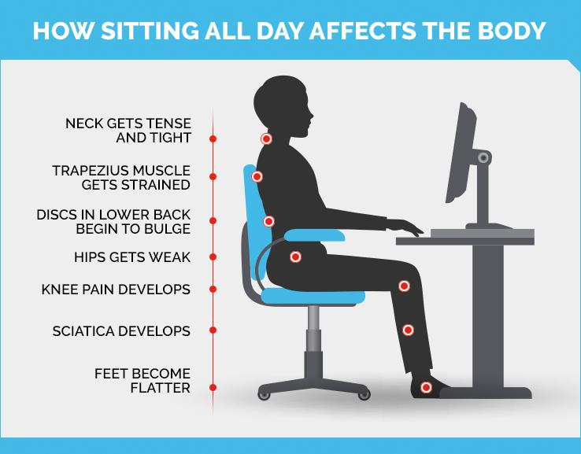
The Problem
Working from Home Increasing Excessive Sitting
Many Related Health Issues
Poor Posture Will Worsen Symptoms
Source: New York Presbyterian

Slide 3
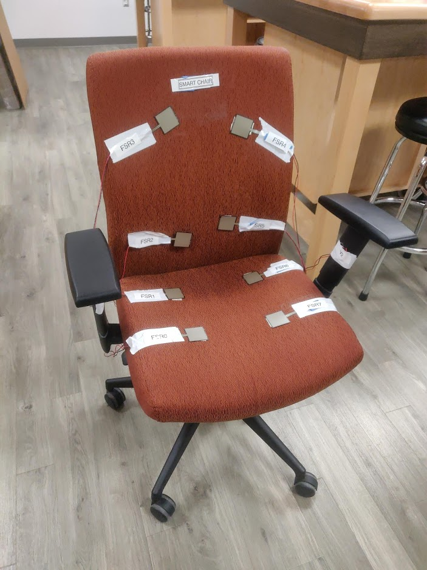
The Posture Watcher
Detects User Sitting Habits
Incorrect posture
Seated too long
When connected via Bluetooth
Data tracked & stored
Settings available in app
Time for seated notification
Frequency of notifications
Power save timeouts

Slide 4
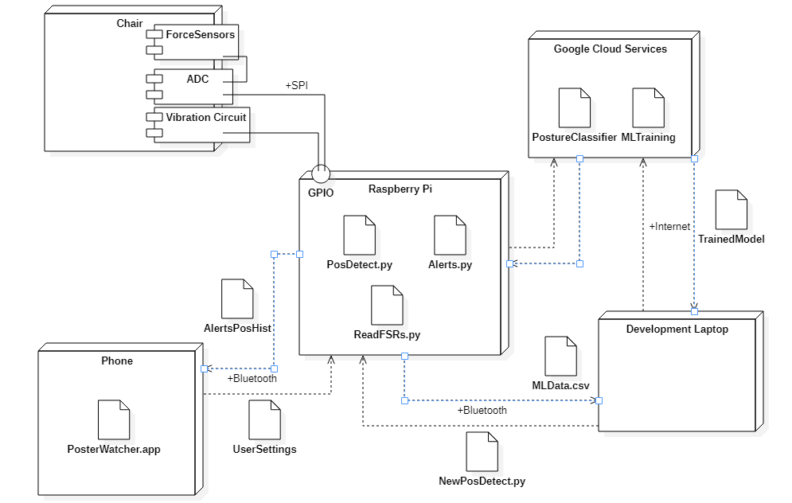
System Architecture

Slide 5
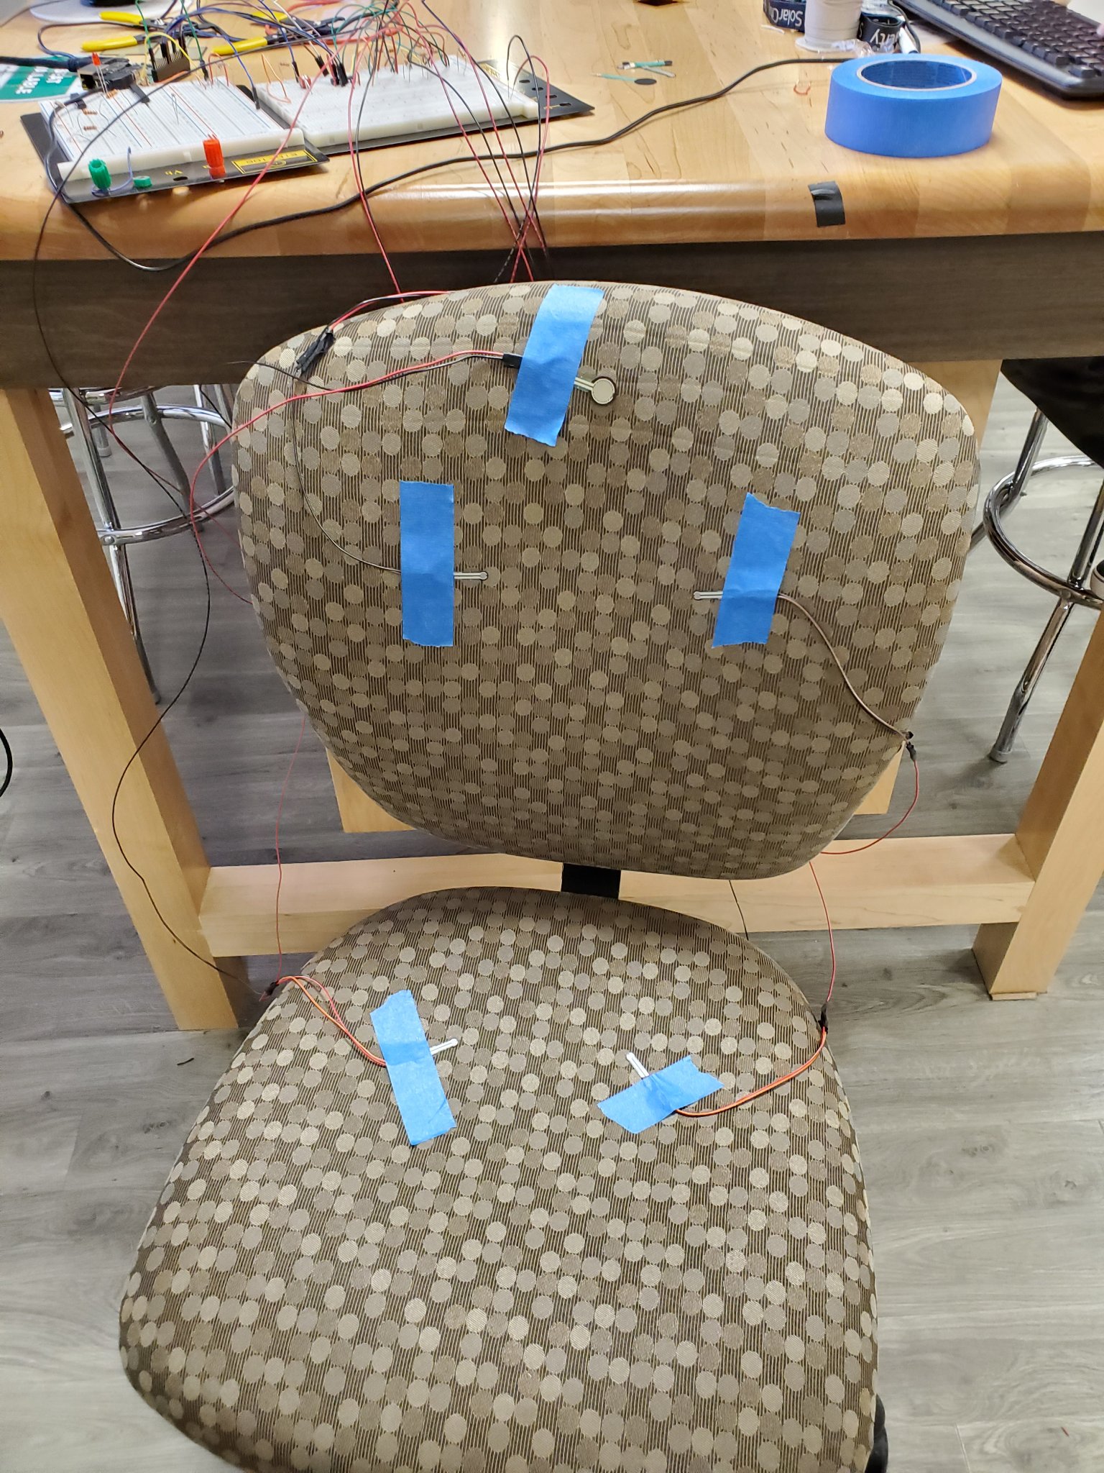
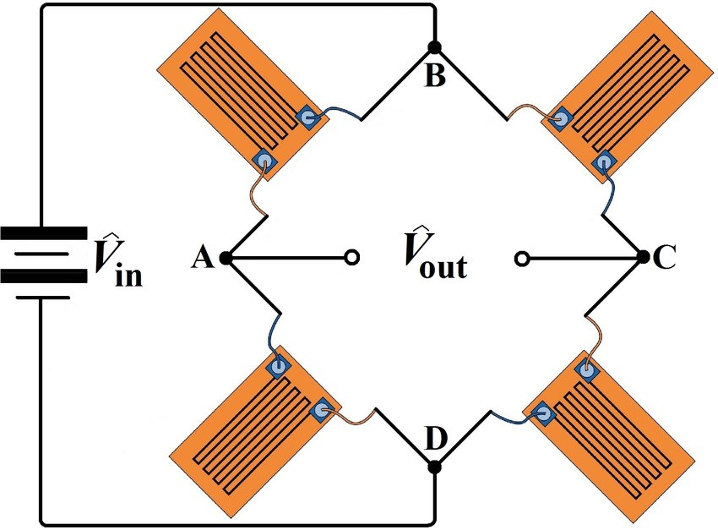
Design Iteration
Strain Gauge Initial Sensors
Protochair with FSRs
Final Product

Slide 6
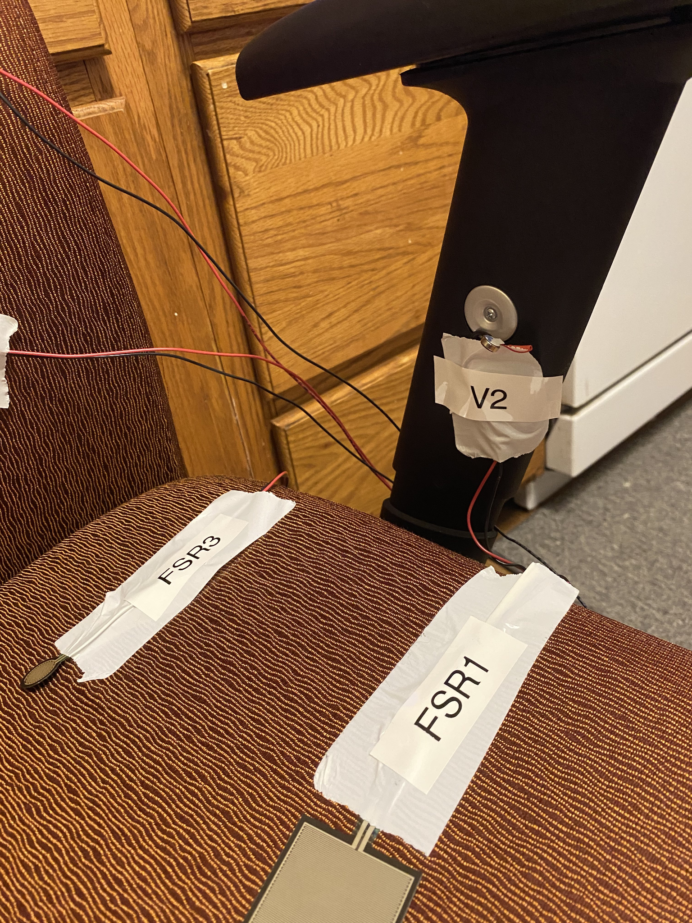
Hardware Design
8 Force Sensitive Resistors in voltage dividers feeding into ADC
Vibration motors powered by Pi to run chair off of singular power source
Runs off of rechargeable USB-C Powerbank for over 16 hours (2 workdays)
FSRs run off of wires from PCB to Chair
Figure: Closeup of Final Product, FSRs and Vibration Motor visible

Slide 7
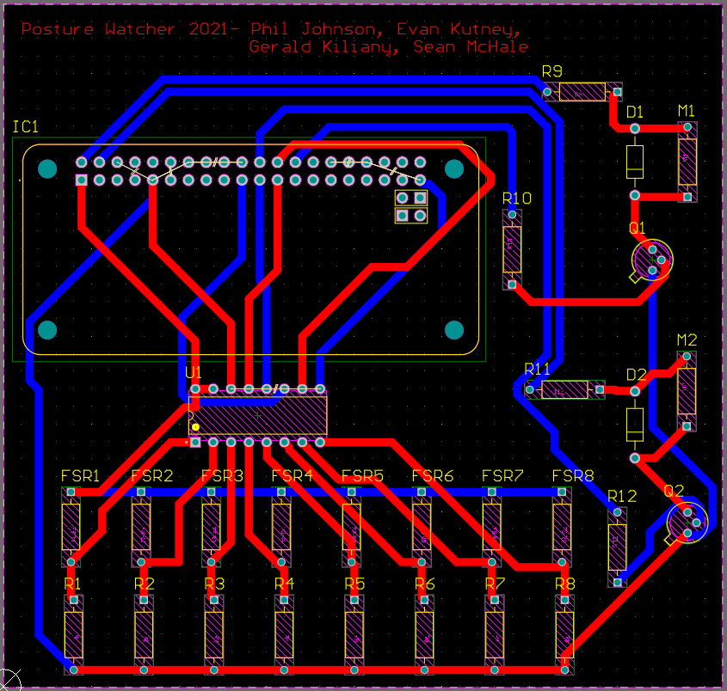
Hardware Testing
Designed for Adults between 5’2”-6’2” weighing between 120-240lbs
ADC switched from HX711 to MCP3008
FSR sensitivity tuned with secondary resistor values
Vibration Motors draw current with switching Transistors
Figure: Final PCB Design, manufactured in SERC

Slide 8
Raspberry Pi Software
Reading sensor values
Seated detection & alerts/powersave timing
Writing data for ML model & app
Running bluetooth connection & main programs on startup
Vibration Mode

Slide 9
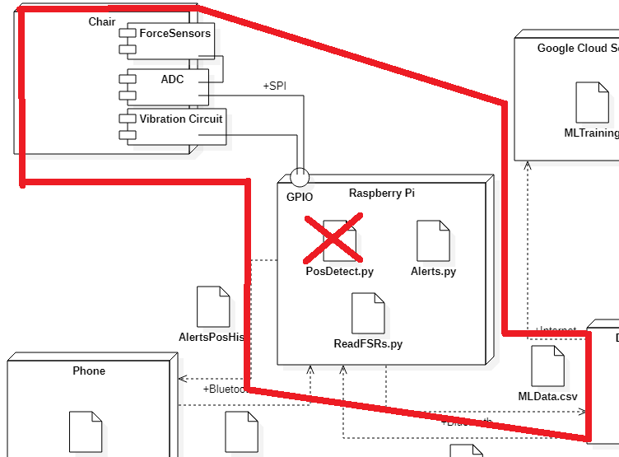
Raspberry Pi Interfacing
SPI communication to ADC
Bluetooth connection (to app)
WiFi connection to Google cloud

Slide 10
MACHINE
LEARNING

Slide 11
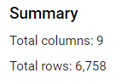
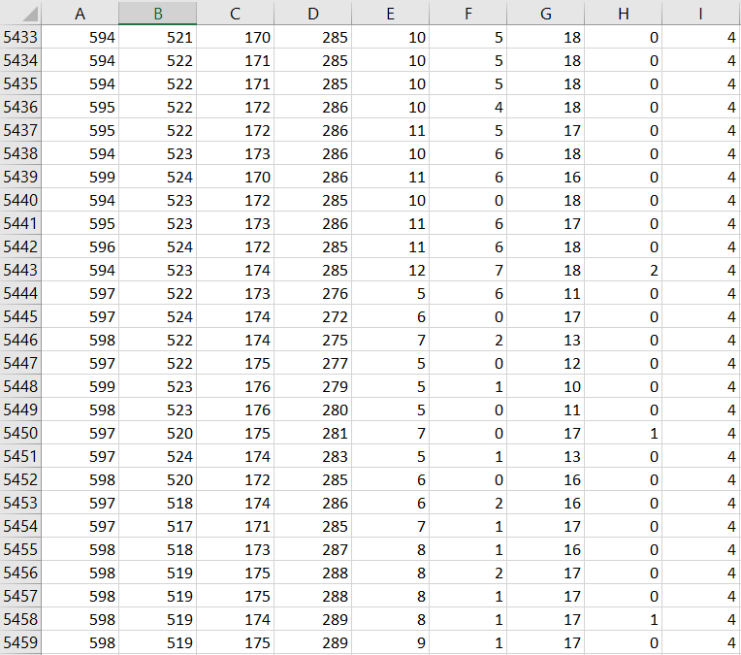
Our Final Model
Gathered 6,758 data points from 8 different users of various sizes
Trained with physically diverse participants to create a robust model
Users weighting between 120 lbs to 240 lbs
Each training data point was then manually labeled into 5 common sitting positions

Slide 12
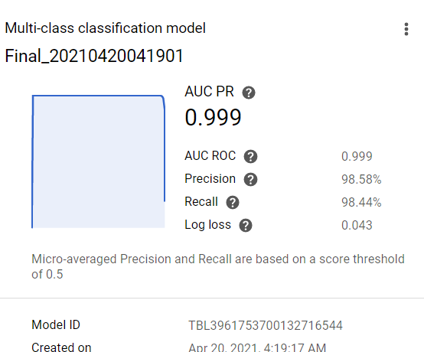
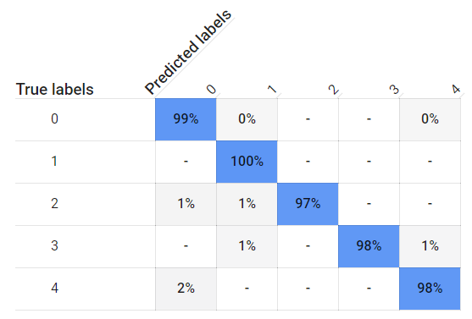

Training the Model gave some impressive results:
Precision: 98.58%

Slide 13
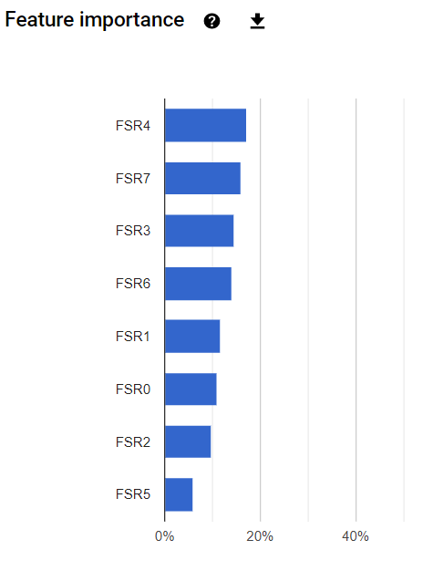
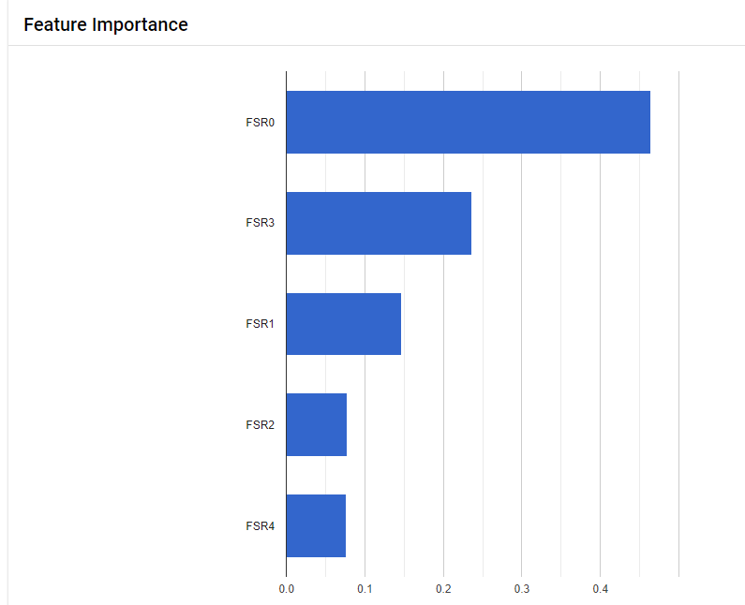
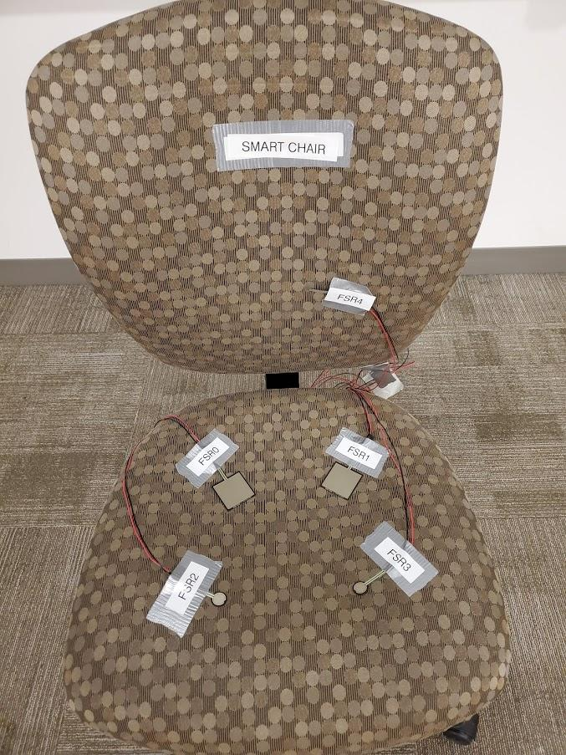
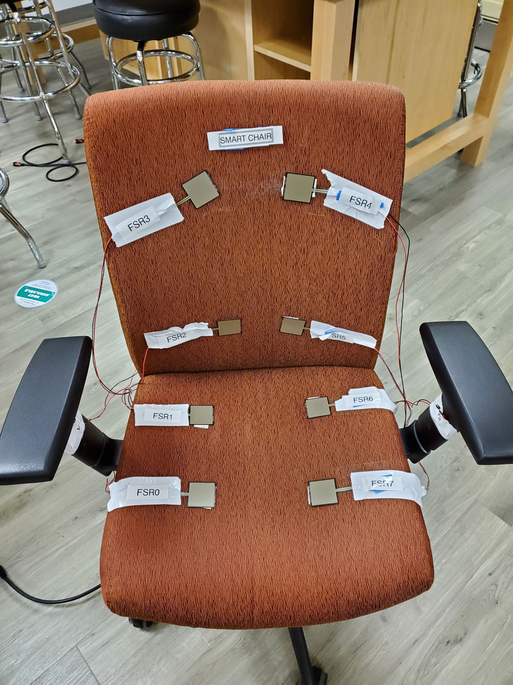
Improved Sensors led to a more even distribution of Feature Weights
New Layout
Old Layout

Slide 14
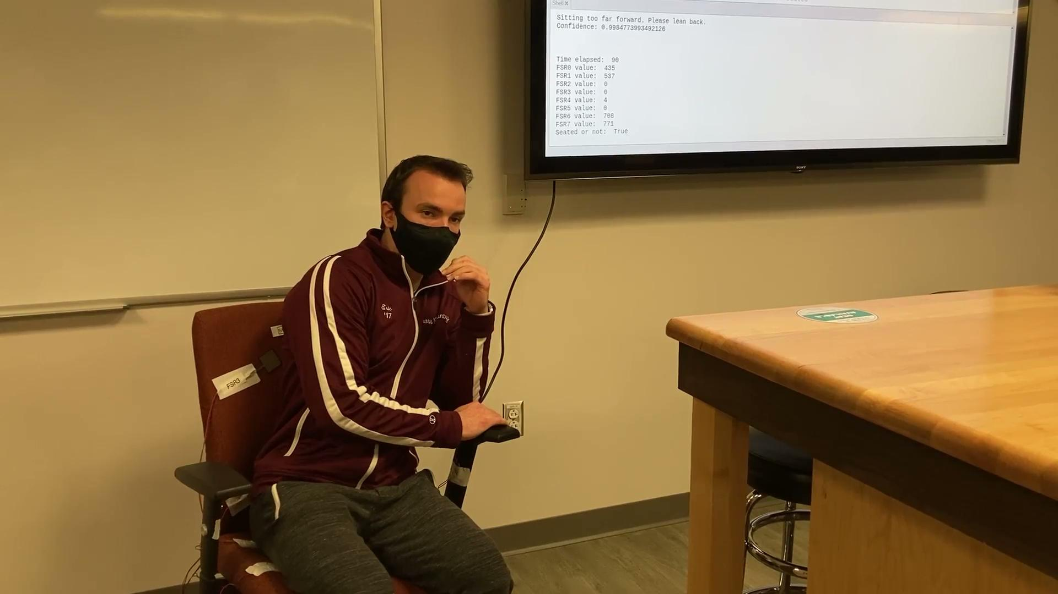

Slide 15
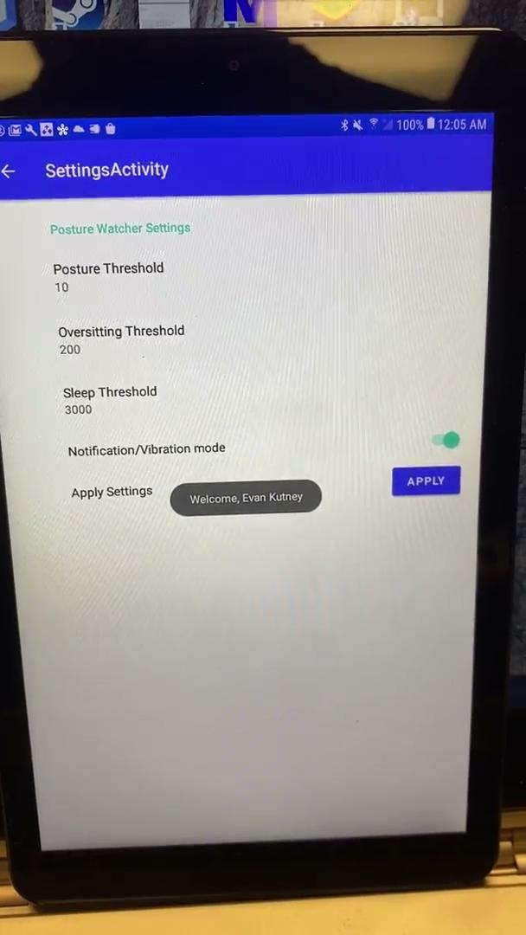
Posture Watcher Android App

Slide 16
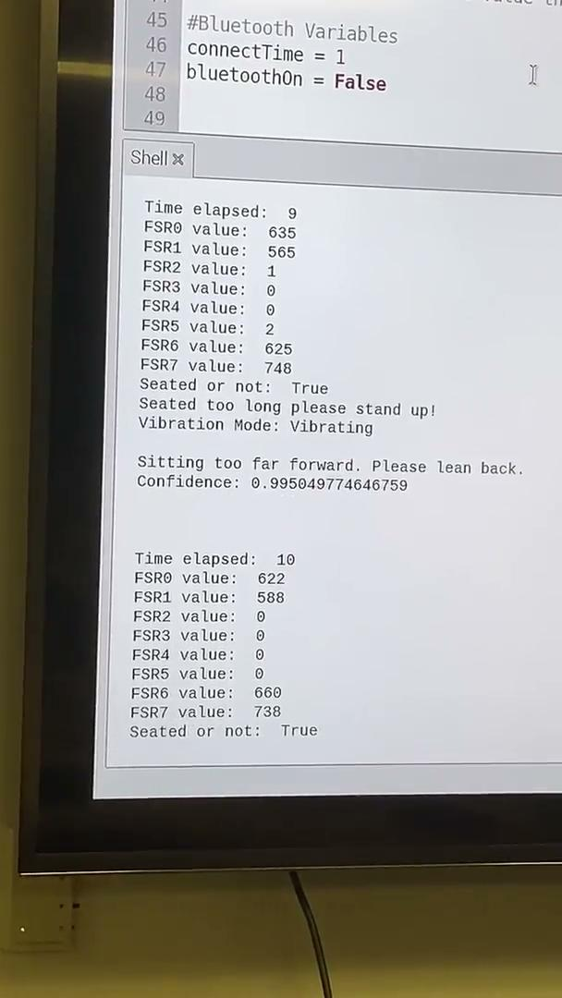
Posture Watcher Android App

Slide 17
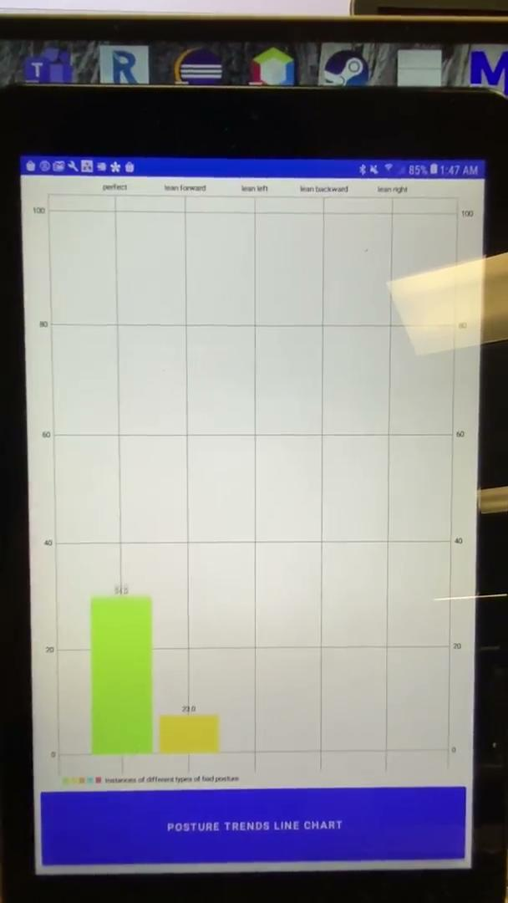

Slide 18
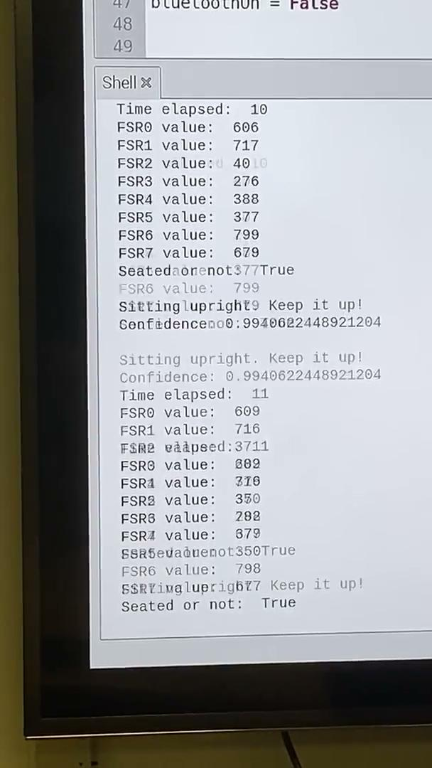

Slide 19
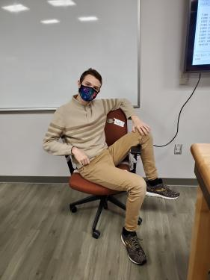
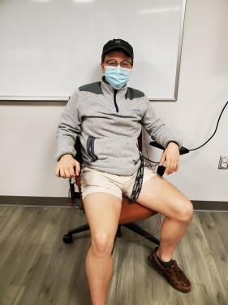
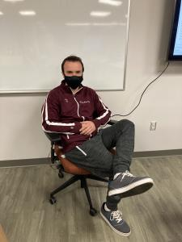
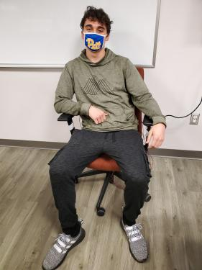
Credits
Sean McHale
-Machine Learning Whisperer
-Hardware putter-togetherer
Phil Johnson
-Hardware Designer
-Business Admin
Gerald Kiliany
-Raspberry Pi Software
-System Interfacing
Evan Kutney
-Bluetooth Comms
-Android App

Slide 20
With Special Thanks To...
Dr. Dickerson
Dr. El-Jaroudi
Dr. Bayoumy
Bill Mcgahey
Jim Lyle
Jessica Dawson
Harsh Selokar
Elijah Hyndman
All training data volunteers
Adafruit
Google
Hyundai
Dolly Parton
Nabisco
Jordan Mann
Fellow Students
All Expo Attendees

Slide 21
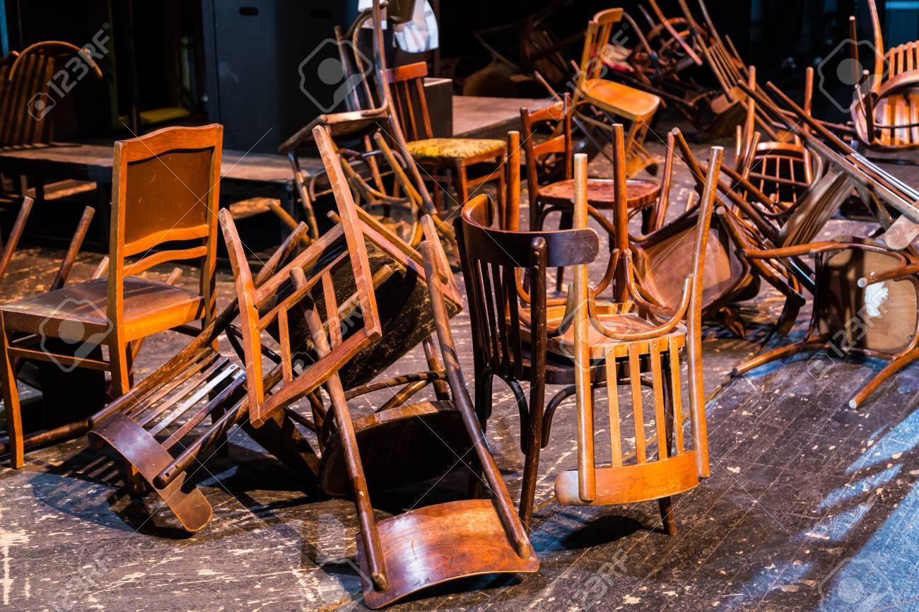

Questions?

